Slide 1

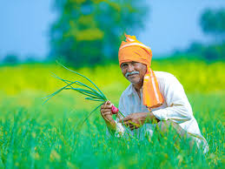
SMART AGRICULTURE SYSTEM USING IOT
Submitted by:
Pallavi Sai Pendurthi
Mail id:
pallavileo3@gmail.com

Slide 2
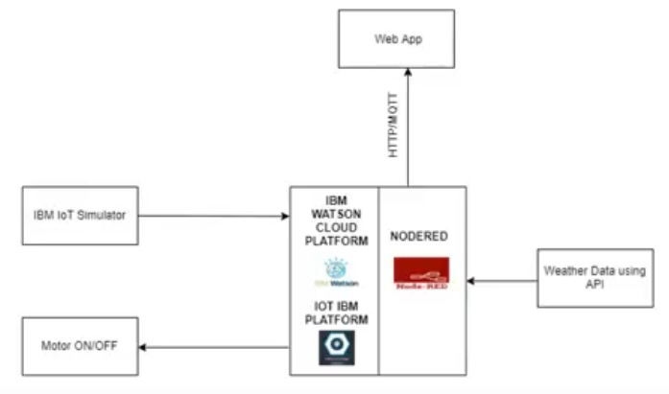
AIM
The aim of the project is to provide farmers an access to continuous monitoring of the weather and soil conditions through a web app which would benefit the farmers in several ways.
DEVELOPMENT:
This project is developed using the watson IoT platform and node red softwares. The data is retrieved from the watson IoT simulator to node red and is displayed in a UI.

Slide 3
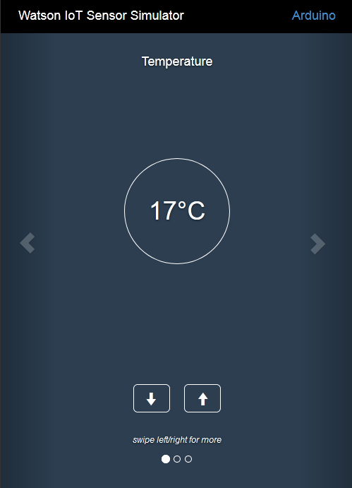
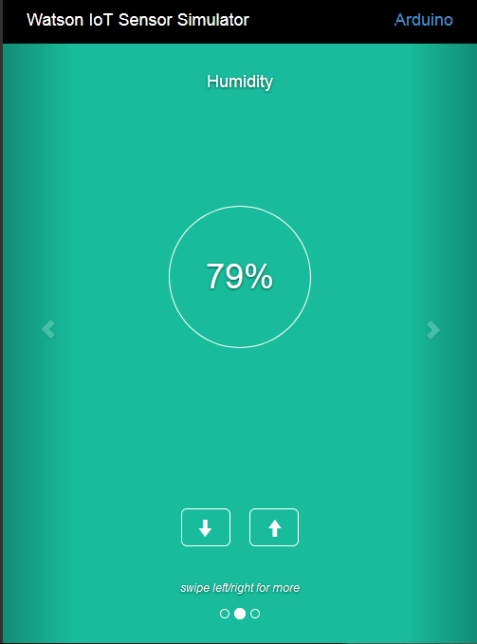
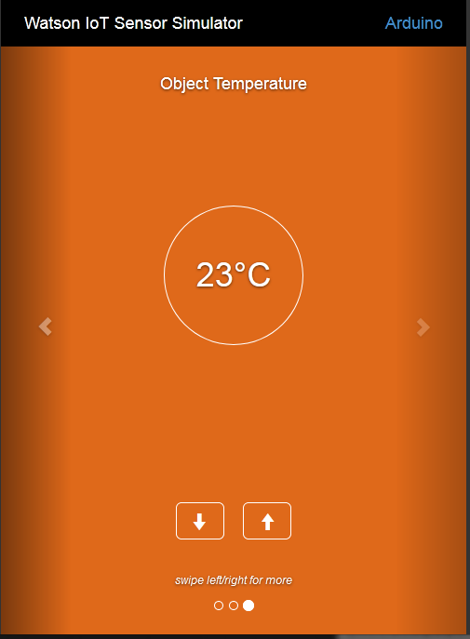
WORKING
Firstly, two devices are created in the watson IoT platform. One is an arduino for temperature, humidity and soil moisture sensor connections and the other is a motor for creating buttons to on and off the motor.
Watson IoT sensor simulator is connected to the platform to display the sensor data.

Slide 4
.
3. An API is generated from the website openweathermaps.org to receive the current weather conditions of a particular place which is selected.
4. In the node-red, nodes are connected accordingly to receive the data from the watson iot sensor and display it in ui using gauges.
5. A python code is written for the connecting the motor device. Using the motor device two buttons are generated for the on and off of the motor.
5. Nodes are also connected to display the weather conditions using the http request node and the generated api key. Finally the generated ui consists of the arduino simulated data, buttons to control the motor and the weather conditions from the open weather API in the form of gauges.

Slide 5
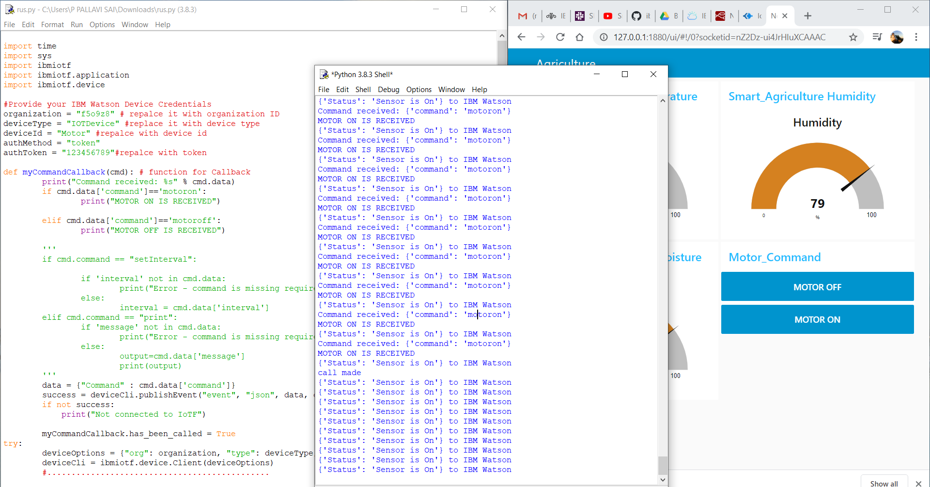
PYTHON CODE FOR MOTOR AND RESULT:

Slide 6
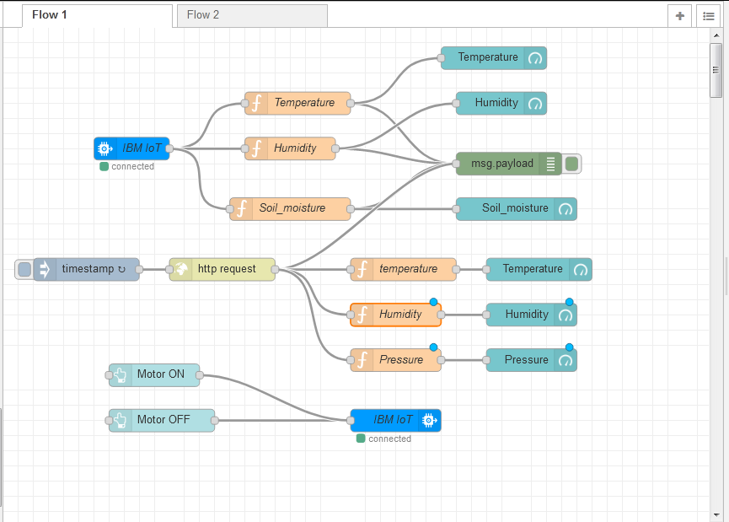
.
FINAL NODE RED FLOW:

Slide 7
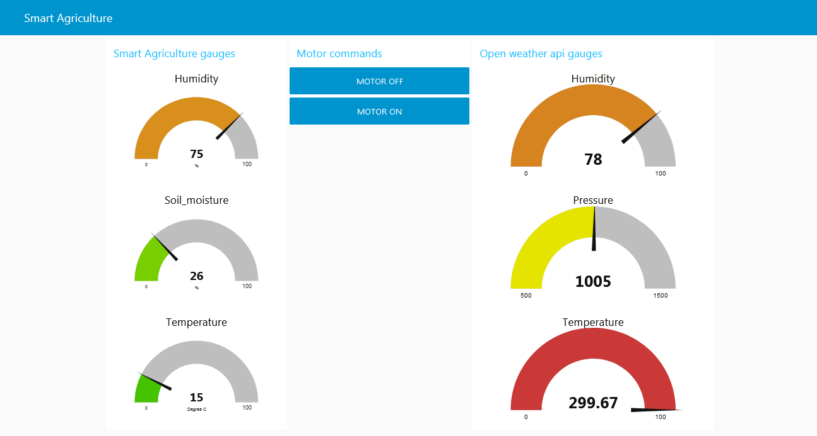
FINAL WEB UI:

